Slide 1
EKF for localization
Day 26

Slide 2
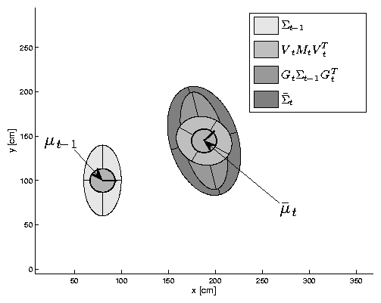
EKF and RoboCup Soccer
simulation of localization using EKF and 6 landmarks (with known correspondences)
robot travels in a circular arc of length 90cm and rotation 45deg

Slide 3
EKF Prediction Step
recall that in the prediction step the state mean and covariance are projected forward in time using the plant model

Slide 4
EKF Prediction Step
position
and
covariance
at previous
time step

Slide 5
EKF Prediction Step
uncertainty
due to
control noise
(small transl.
and rot. noise)

Slide 6
EKF Prediction Step
previous
uncertainty
projected
through
process
model

Slide 7
EKF Prediction Step
net
predicted
uncertainty

Slide 8
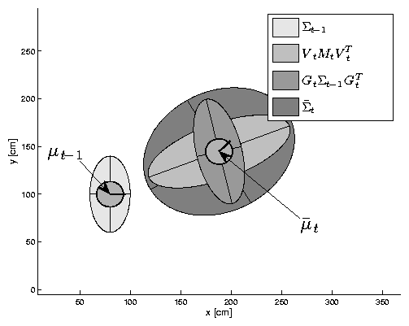
EKF Prediction Step
uncertainty
due to
control noise
(large transl.
and small
rot. noise)

Slide 9
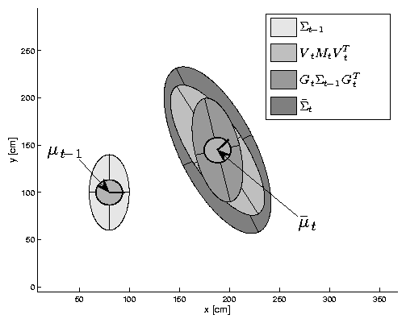
EKF Prediction Step
uncertainty
due to
control noise
(small transl.
and large
rot. noise)

Slide 10
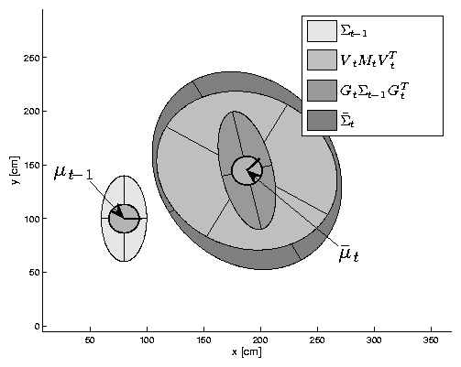
EKF Prediction Step
uncertainty
due to
control noise
(large transl.
and large
rot. noise)

Slide 11
EKF Observation Prediction Step
in the first part of the correction step, the measurement model is used to predict the measurement and its covariance using the predicted state and its covariance

Slide 12
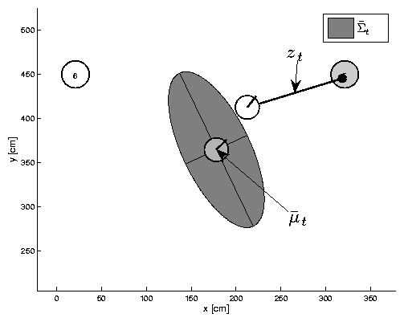
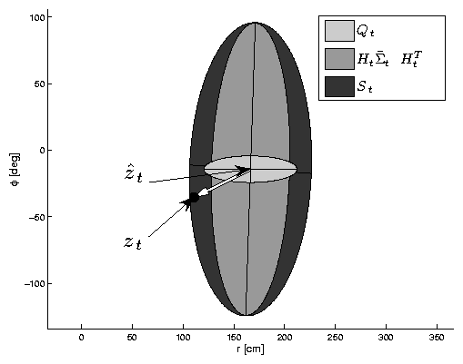
EKF Observation Prediction Step
predicted
state with
covariance
predicted
landmark
observation
landmark
observation

Slide 13
EKF Observation Prediction Step
predicted
state with
uncertainty
observation
uncertainty
landmark
observation

Slide 14
EKF Observation Prediction Step
uncertainty
due to
uncertainty
in predicted
robot position
predicted
state with
covariance
landmark
observation

Slide 15
EKF Observation Prediction Step
innovation
(difference
between
predicted and
actual observations)
predicted
state with
covariance
landmark
observation

Slide 16
EKF Observation Prediction Step
predicted
state with
uncertainty
observation
uncertainty
(large distance
uncertainty)
landmark
observation

Slide 17
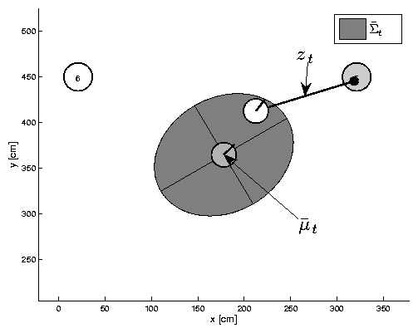
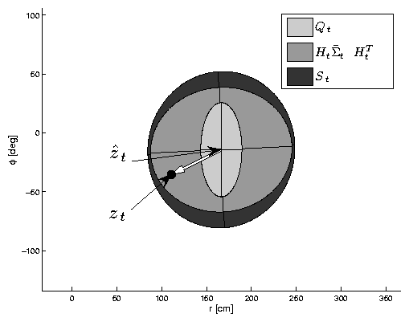
EKF Observation Prediction Step
predicted
state with
uncertainty
observation
uncertainty
(large bearing
uncertainty)
landmark
observation

Slide 18
EKF Correction Step
the correction step updates the state estimate using the innovation vector and the measurement prediction uncertainty

Slide 19
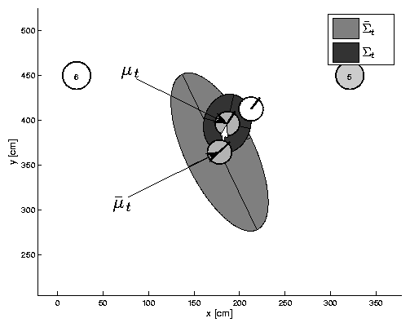
EKF Correction Step
innovation
(difference
between
predicted and
actual observations)
innovation scaled
and mapped into
state space

Slide 20
EKF Correction Step
corrected
state mean
corrected
state
uncertainty

Slide 21
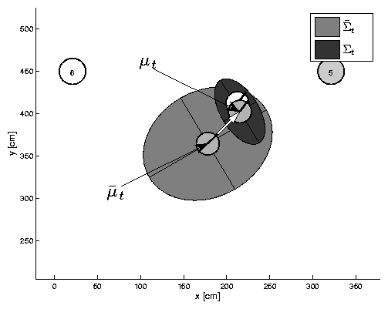
EKF Correction Step

Slide 22
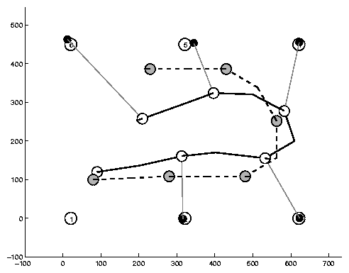
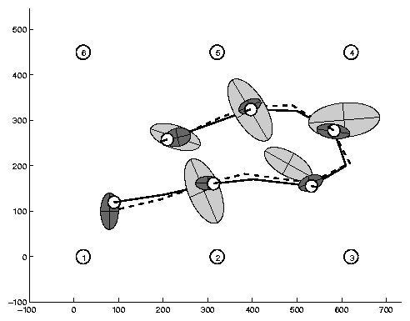
Estimation Sequence (1)
initial
position
uncertainty
EKF
estimated
path
true path
motion model
estimated path
landmark
measurement
event
predicted
position
uncertainty
corrected
position
uncertainty

Slide 23
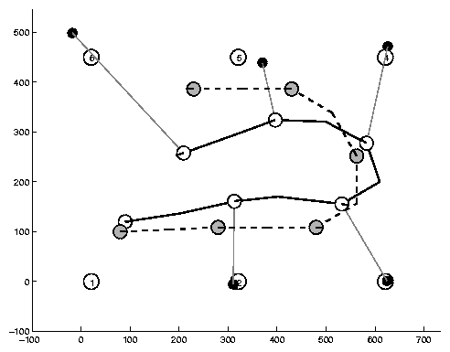
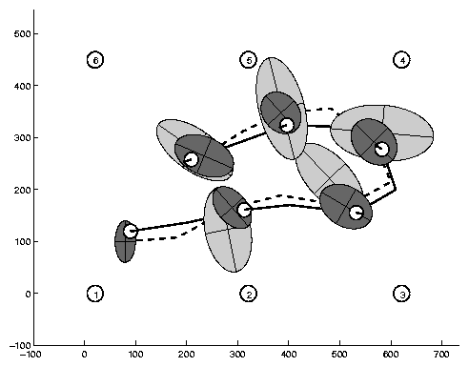
Estimation Sequence (2)
same as previous but with greater measurement uncertainty

Slide 24
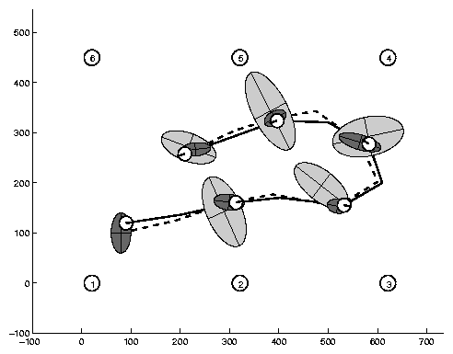
Comparison to GroundTruth

Slide 25
EKF Summary
Highly efficient: Polynomial in measurement dimensionality k and state dimensionality n:
O(k^{2.376} + n²)
Not optimal!
Can diverge if nonlinearities are large!
Works surprisingly well even when all assumptions are violated!

